Slide 1
18. NumPy - Slicing
Slicing Operation in NumPy Array
How to retrieve collection of elements from 1 dimensional array 2 dimensional array and 3 dimensional array in detail.
https://www.youtube.com/watch?v=fIXh-gmR7mQ

Slide 2
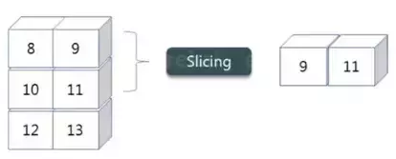
Slicing
As you can see the ‘reshape’ function has showed its magic. Now, let’s take another operation i.e Slicing. Slicing is basically extracting particular set of elements from an array. This slicing operation is pretty much similar to the one which is there in the list as well.
We have an array and we need a particular element (say 3) out of a given array. Let’s consider the below example:
import numpy as np
a = np.array([(1,2,3,4),(3,4,5,6)])
print(a[0,2])
OUTPUT : 3
Here, the array(1,2,3,4) is your index 0 and (3,4,5,6) is index 1 of the python numpy array. Therefore, we have printed the second element from the zeroth index.

Slide 3

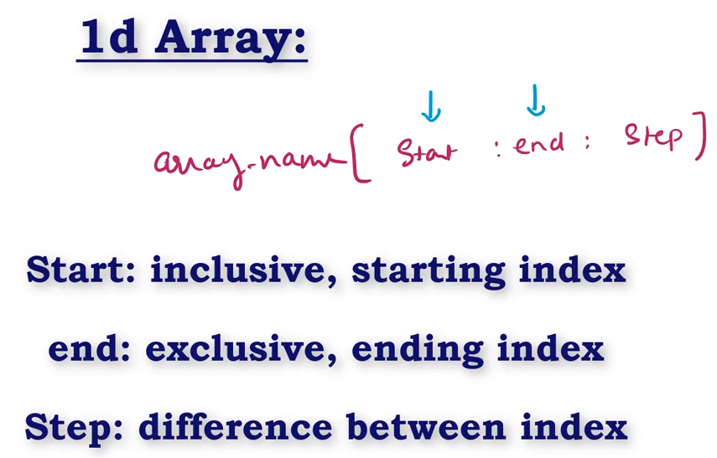
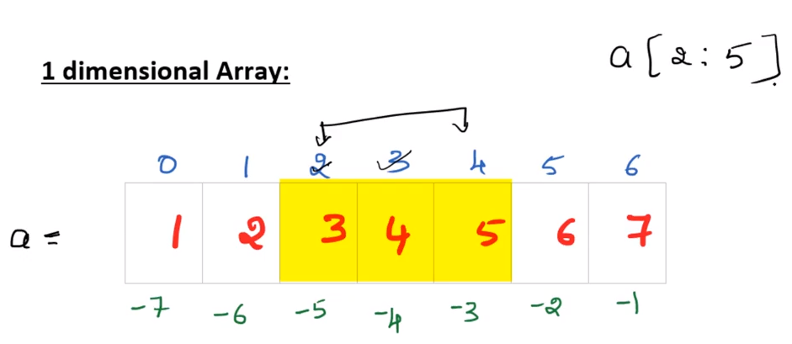
a[ : ] ----- Entire Array
a[ : 3] ----- It will take from 0 index
a[1 : ] ----- It will take end of the Array

Slide 4
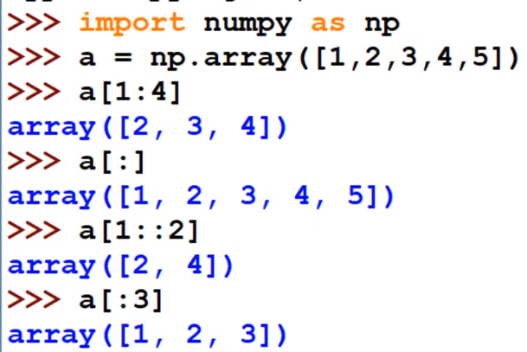
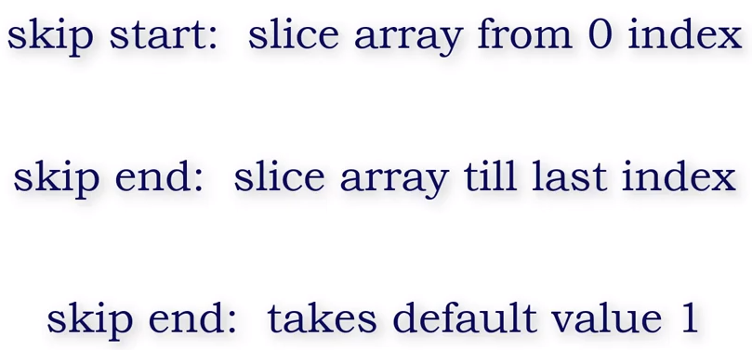

Slide 5
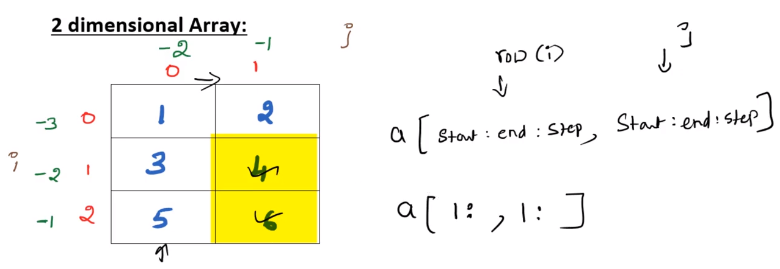

Slide 6
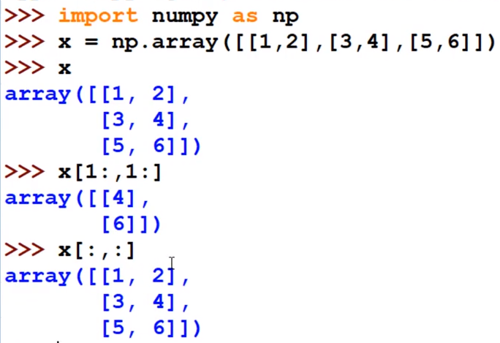

Slide 7
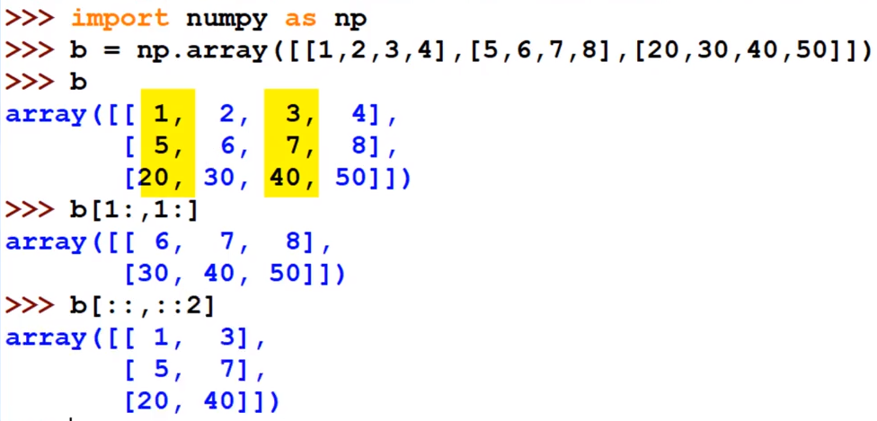

Slide 8
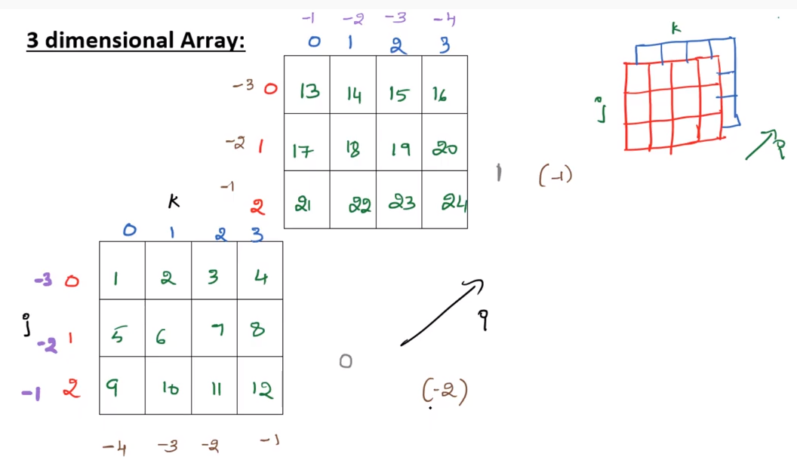

Slide 9
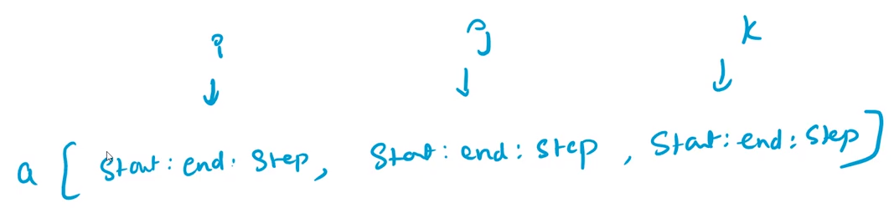
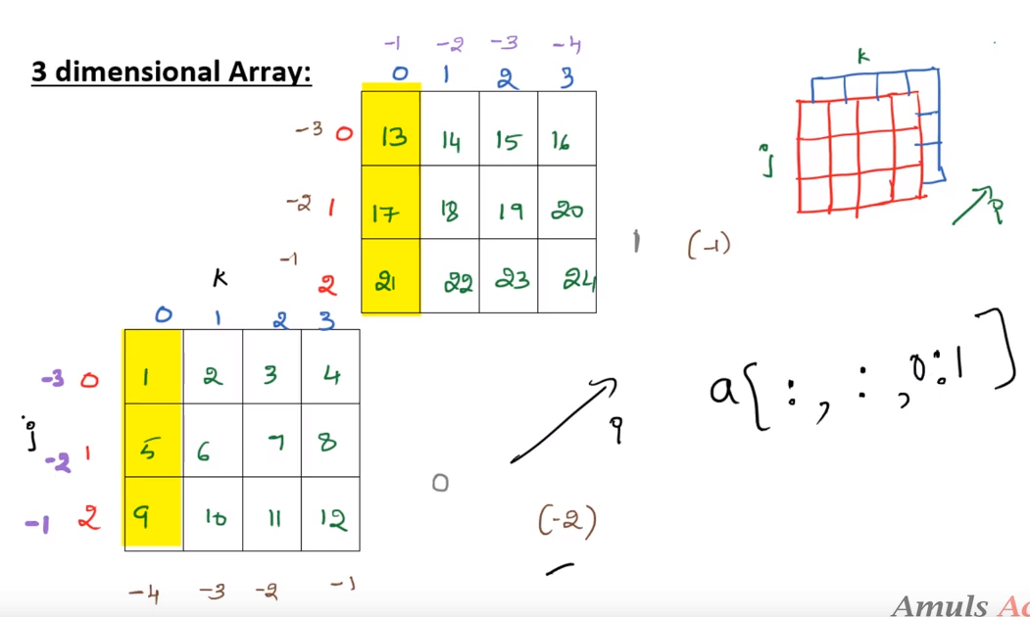

Slide 10
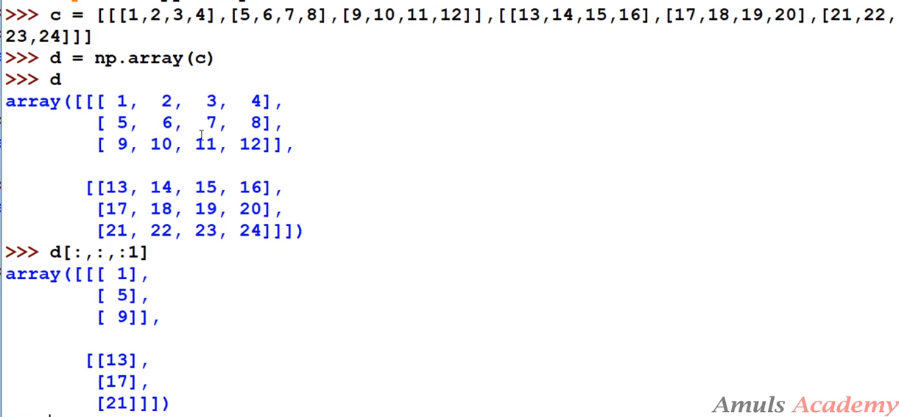

Slide 11
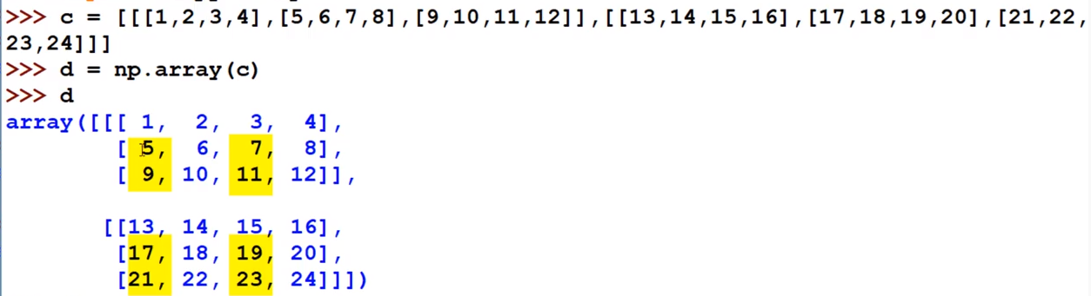
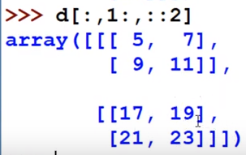

Slide 12
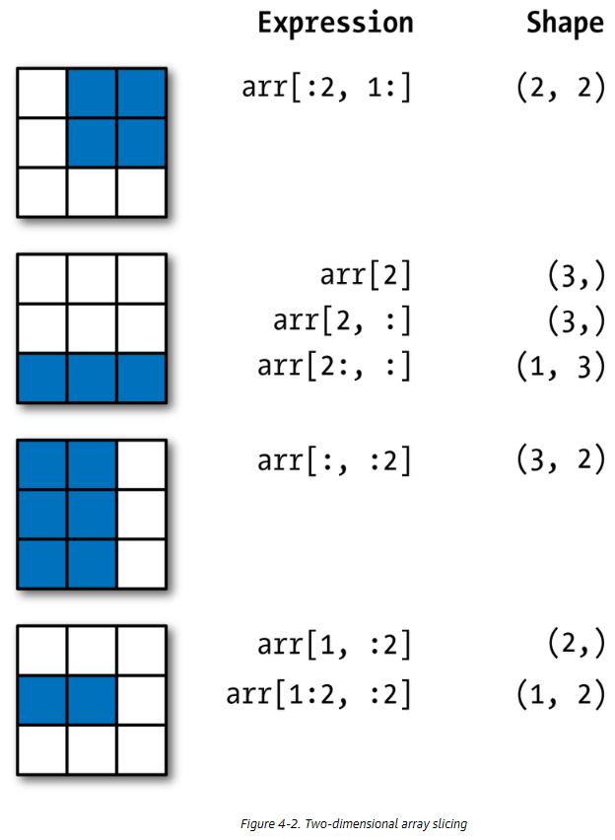
Two-dimensional array slicing

